Slide 1
Wild Animal Detection and Alert System
using Deep Learning
Project by:
Neetha Mariam Sam
Punnoose K Thomas
Sharooque K P
Sreya Jain Tobji
Guided by :
Er.Soumya Sara Koshy

Slide 2
INTRODUCTION
The increase in human population in India propelled by agricultural and industrial growth has led to the conversion of the forest lands into human settlements.
Due to this, the wild elephant and other animal populations face acute shortage of resources such as water and food, making them move often into the human habitat.
These animals wait near villages for nightfall to eat crops and have been known to kill people.
The development of this project can help to track the presence of animals in residential areas and avoid the chance of interference and harm of animal and human life.

Slide 3
APPLICATION
Can be used to detect animals activity near forest boundaries to take necessary precautions.
Can be used to monitor possible animal attacks on people/property through video surveillance
Can be used to alert forest rangers before hand of animals crossing to human territory

Slide 4
OBJECTIVE
Identify wild animals with from video cameras placed at forest borders
Use deep learning techniques for the development of the model
Develop effective alert systems to avoid consequences

Slide 5
EXISTING SOLUTIONS
Obtain data about the visual aspects of animal from the camera-trap images and are checked mannualy.

Slide 6
INNOVATIONS
The real time video is divided into frames and taken at fixed intervals
YOLOv2 algorithm is then used for object detection
Alert concerned person to take measures through wired Arduino and wireless IoT module

Slide 7
LITERATURE SURVEY
Wild Animal Detecting and Monitoring - by Eric Tang [1]
Microsoft Embedded Learning Library used for detection
IR triggered Pi camera used for input
Detected result sent via cellular network.
Animal Recognition and Identification with Deep Convolutional Neural Networks for Automated Wildlife Monitoring - by Hung Nguyen, Sarah J. Maclagan, Tu Dinh Nguyen, Thin Nguyen, Paul Flemons, Kylie Andrews, Euan G. Ritchie, Dinh Phung[2]
Automated monitoring system
Trained using single-labeled dataset
Capable of filtering animal images and identifying species.

Slide 8
LITERATURE SURVEY (CONT.)
Early Warning System From Threat of Wild Animals Using Raspberry Pi - by Ms. M.Malarmathi, R.Gokulnath, S.Yuvaraj, R.Karthikeyan[3]
Captures images of animals using Raspberry Pi
Compares image with images from database to identify animal
Generates alert from database
Animal Detection From Highly Cluttered Natural Scenes Using Spatiotemporal Object Region Proposals and Patch Verification - by Zhi Zhang, Zhihai He, Guitao Cao, Wenming Cao[4]
Joint DL used for primary identification.
Cross-frame temporal patch verification method is used to distinguish between animals and dynamic background to eliminate false positives.

Slide 9
LITERATURE SURVEY (CONT.)
Wildlife Surveillance using Deep Learning Methods - by Ruilong Chen, Ruth Little, Lyudmila Mihaylova, Richard Delahay, Ruth Cox[5]
CNN architecture
ResNet Training Model
Wild Animal Detection from Highly Cluttered Forest Images Using Deep Residual Networks - by Anamika Dhillon, Gyanendra K. Verma[6]
Deep ResNet used for feature extraction
Support Vector Machine, K-Neighbor and Ensemble Tree used
Notes:
5. CNN architecture used with ResNet model to detect animals.
6.

Slide 10
Components used
Arduino Module - version Uno
USB cable to connect Arduino to Processing System
BOLT IoT Module - WiFi Module with custom Firmware and ESP8266
Buzzer for Audio Alert Generation

Slide 11
METHODOLOGY
Capture the real time video using camera module.
The video is divided into frames.
An image is a single frame.
YOLOv2 algorithm is then used for object detection.
Uses model pre-trained on the imagenet dataset of animals.
If a wild animal like tiger or elephant is detected, then buzzers or sound alert systems are activated to alert forest officers.
An alert in the form of SMS is also generated to inform required authorities.

Slide 12
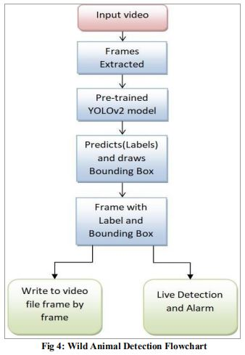
METHODOLOGY
Wild animal detection flowchart

Slide 13
METHODOLOGY (CONTD.)
The image is divided as grids of matrices.
Each grid undergoes classification and localization of the object.
It then predicts the bounding boxes and their corresponding class probabilities.

Slide 14
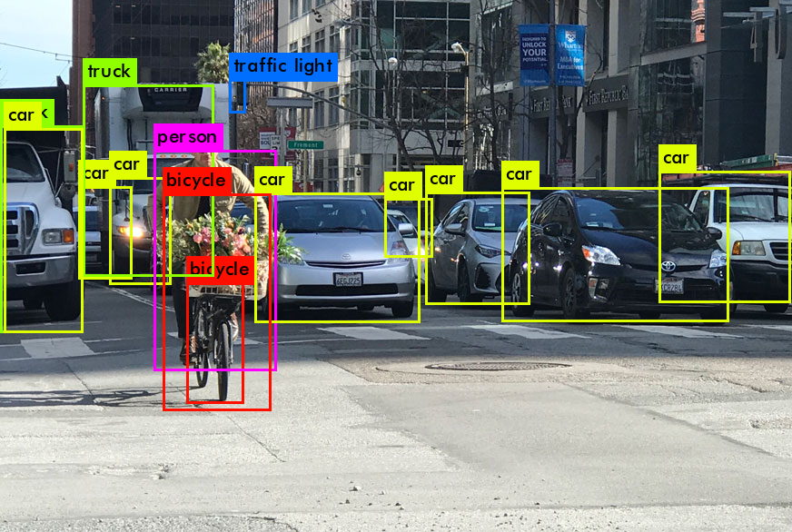
WORKING OF YOLO (CONTD.)
Figure 1: Bounding box and class values

Slide 15
WORKING OF YOLO (CONTD.)
YOLOv2 uses a variant of Darknet 19
It has 19 convolutional layers and 5 max-pooling layers.
YOLO v2 is faster than YOLO v3.

Slide 16
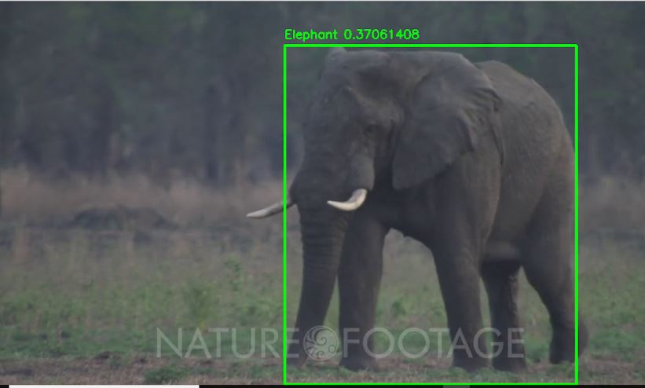
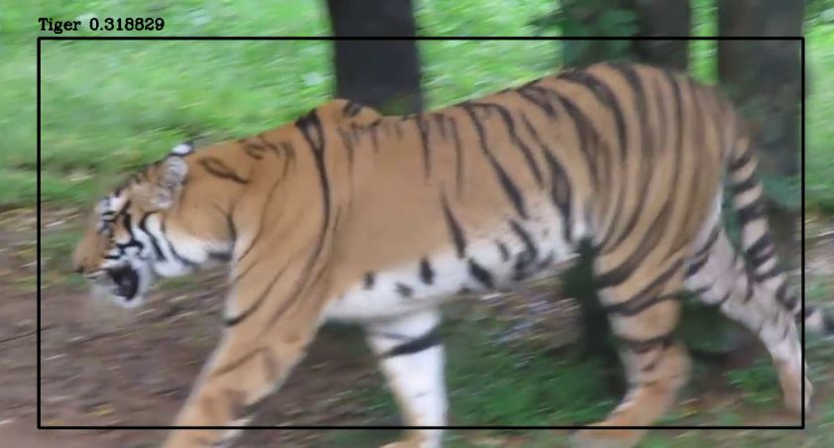

Slide 17
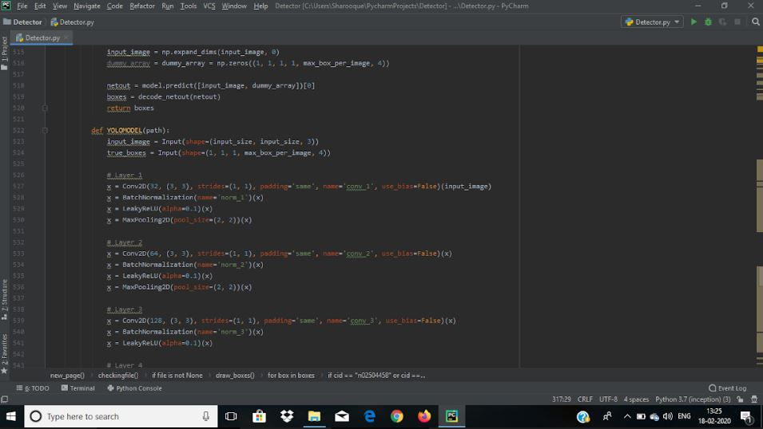

Slide 18
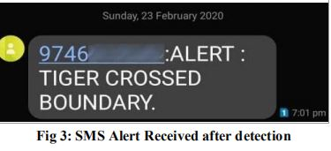
SMS alert received after detection

Slide 19
Previous works
Inception v3 model pre-trained on imagenet
Classifies animals like tiger and lion from video
Produces alert on identification
DISADVANTAGES OF INCEPTION v3:
Unable to detect multiple objects(multi label classification) in a single frame
Can only classify one object at a time

Slide 20
EXPECTED LIMITATIONS
Reduced accuracy in low light or low visibility
Reduced accuracy or false positives in case of low resolution videos
False negatives or reduced accuracy in case of videos with occlusions
Slight lag between animal detection, animal classification and alert during live application
Precision of training model greatly depends on accuracy of Data Augmentation algorithm
Size of input data is very large and necessary preprocessing causes slight lag

Slide 21
CONCLUSION
This system provides solution for unsupervised process of identification of wild animals. The system is completely automated. Optimal results for automated identification of individual animals are obtained with the algorithm developed and also with an early warning sent to the forest officials as well as the villagers about the arrival of animal towards village.

Slide 22
Achievements
Cleared First round of CSI-InApp Nation Student Project Awards.
Participated in ICITST Conference.

Slide 23
REFERENCES
Wild Animal Detecting and Monitoring - by Eric Tang
Animal Recognition and Identification with Deep Convolutional Neural Networks for Automated Wildlife Monitoring - by Hung Nguyen, Sarah J. Maclagan, Tu Dinh Nguyen, Thin Nguyen, Paul Flemons, Kylie Andrews, Euan G. Ritchie, Dinh Phung[2]
Ms. M.Malarmathi, R.Gokulnath, S.Yuvaraj, R.Karthikeyan[3]
Animal Detection From Highly Cluttered Natural Scenes Using Spatiotemporal Object Region Proposals and Patch Verification - by Zhi Zhang, Zhihai He, Guitao Cao, Wenming Cao[4]
Wildlife Surveillance using Deep Learning Methods - by Ruilong Chen, Ruth Little, Lyudmila Mihaylova, Richard Delahay, Ruth Cox[5]
Wild Animal Detection from Highly Cluttered Forest Images Using Deep Residual Networks - by Anamika Dhillon, Gyanendra K. Verma[6]

